Slide 1
Statistical Methods in
ISO/IEC 17043 and ISO 13528
Requirements and Guidelines

Slide 2
When is Statistics Relevant
Planning and Design
Homogeneity testing
Stability testing
Determining Assigned Values
Determining SD for Proficiency Assessment
Performance assessment
Summary statistics

Slide 3
Overview
Requirements for statistical methods from ISO/IEC 17043
Overview of statistical procedures in the major standards
Determining the assigned value
Determining the performance score
Checking homogeneity and stability
Graphical methods
Examples from APLAC and IMEP PT programmes

Slide 4
Documents for PT Statistics
ISO/IEC 17043: 2010
Conformity Assessment – General requirements for Proficiency Testing (replacing Guide 43-1 and 2:1997)
ISO 13528: 2005
Statistical Methods for use in Proficiency Testing by Interlaboratory Comparisons

Slide 5
ISO/IEC 17043
assigned value (ISO/IEC 17043, clause 3.1)
value attributed to a particular property of a proficiency test item
assigned value (ISO 13528, clause 3.3)
value attributed to a particular quantity and accepted, sometimes by convention, as having an uncertainty appropriate for a given purpose

Slide 6
ISO/IEC 17043
  3.5 outlier
  observation in a set of data that appears to be inconsistent with the remainder of that set
  NOTE An outlier can originate from a different population or be the result of an incorrect or other gross error
  Assumption:
  when a lab’s result is classified as an outlier, its performance is regarded as unsatisfactory
    But it is not appropriate to call all unsatisfactory results ‘outliers’
  It is a prima facie evidence and the lab needs to investigate its operation
  There may be other valid reasons not relating to performance causing its result classified as outlier

Slide 7
ISO 13528
Written by ISO TC69, SC6
Approved work item in 1997
Published in 2005
Reaffirmed in 2009
Now under revision
Still in CD
CD1 passed ballot, but will re-ballot as CD

Slide 8
Other ISO Documents for PT Statistics
ISO /TR 13425: 2006 Guidelines for the selection of statistical methods in standardization and specification
ISO 16269-4: 2011
Statistical interpretation of data: Part 4: Detection and treatment of outliers

Slide 9
ISO 13425
A descriptive catalogue of the available TC69 International Standards and Guides
Assist in selecting most suitable for a particular purpose
Gives non-technical abstracts and technical abstracts

Slide 10
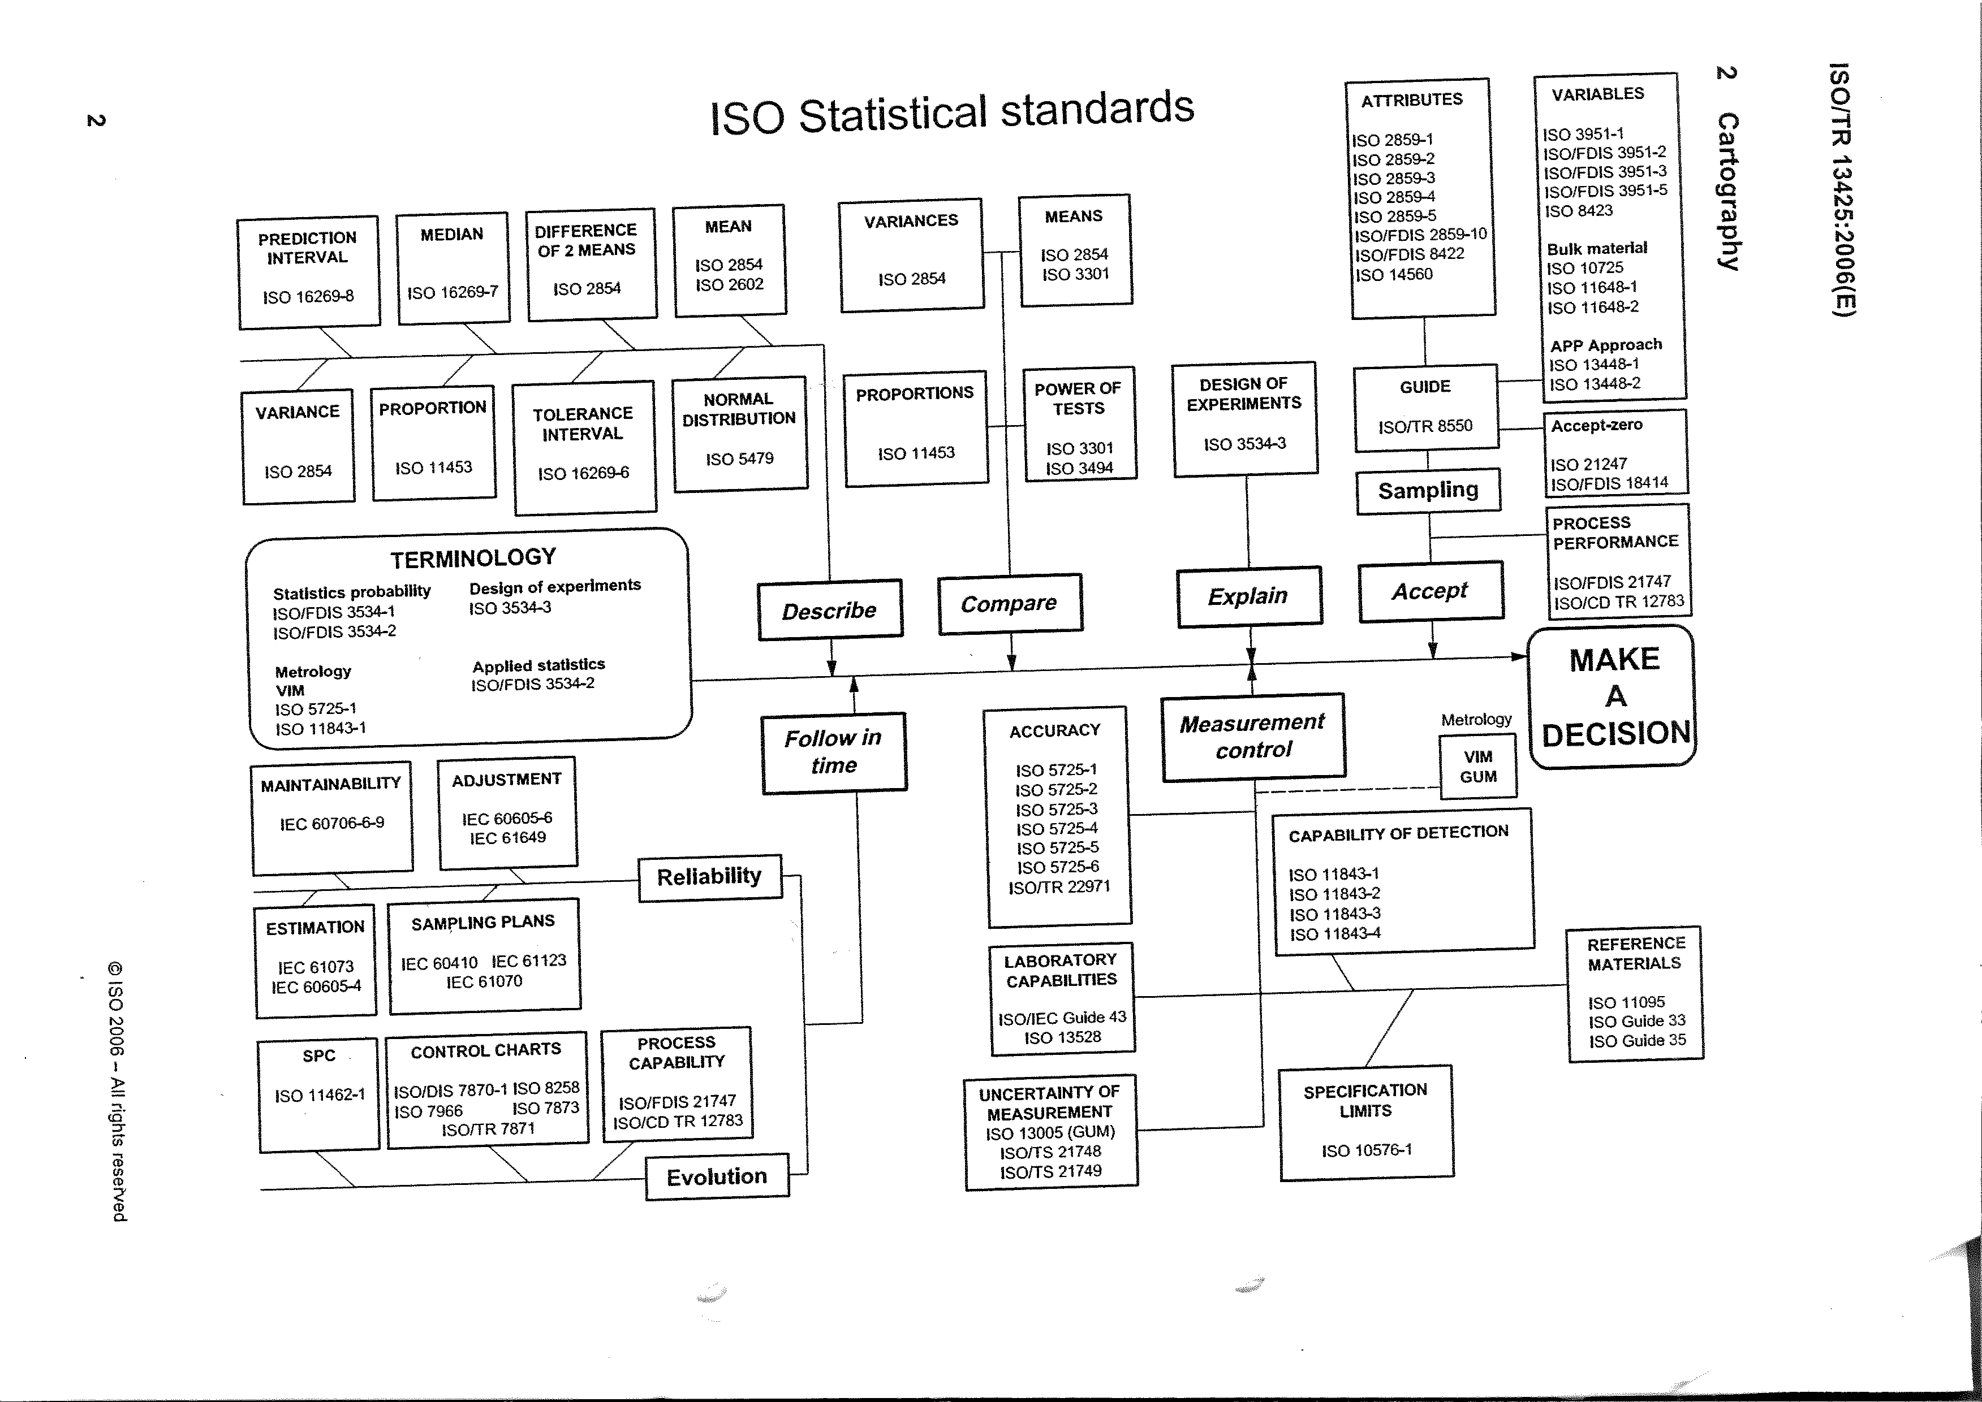

Slide 11
ISO 16269-4
Provides detailed descriptions of sound statistical testing procedures and graphical data analysis methods for detecting outliers in data
Primarily designed for the detection and accommodation of outlier(s)
Identify and standardize a sound subset of methods used in the identification and treatment of outliers

Slide 12
Other Documents for PT Statistics
The International Harmonized Protocol for Proficiency Testing of Analytical Chemistry Laboratories (IUPAC Technical Report) 2006
(http://www.iupac.org/publications/pac/2006/pdf/7801x0145.pdf)
IUPAC/CITAC Guide: Selection and use of proficiency testing schemes for a limited number of participants – chemical analytical laboratories (IUPAC Technical Report) 2010
(http://iupac.org/publications/pac/pdf/2010/pdf/8205x1099.pdf)

Slide 13
Other Documents for PT Statistics
Eurachem Guide: Selection, Use and Interpretation of proficiency testing (2011)
  ( http://www.eurachem.org/index.php/publications/guides/usingpt )

Slide 14
ISO/IEC 17043: 2010
Conformity assessment – General requirements for proficiency testing

Slide 15
ISO/IEC 17043
Requirements relating to statistics
4.2 Personnel
  4.2.4 The PTP shall authorize specific personnel to:
  ….
  h) conduct statistical analysis
  ….

Slide 16
ISO/IEC 17043
Requirements relating to statistics
4.4 Design of proficiency testing scheme
  4.4.1 Planning
    4.4.1.3 The PTP shall document ...the following information..
  p) detailed description of the statistical analysis to be used;
  q) the origin, metrological traceability and measurement uncertainty of any assigned values;
  r) criteria for the evaluation of performance of participants;
  s) a description of the data, interim reports or information to be returned to participants;
4.4.1.4 The PTP shall be access to the necessary technical expertise and experience in …. statistics

Slide 17
ISO/IEC 17043
4.4.3 Homogeneity and stability
4.4.3.2 The procedure for the assessment of homogeneity and stability shall be documented and conducted, where applicable, in accordance with appropriate statistical designs. Where possible, the PTP shall use a statistically random selection of a representative number of proficiency testing items from the whole batch of test material in order to assess the homogeneity of the material.

Slide 18
ISO/IEC 17043
4.4.4 Statistical design
4.4.4.1 Statistical designs shall be developed to meet the objectives of the scheme, based on the nature of the data (quantitative or qualitative, including ordinal and categorical), statistical assumptions, the nature of errors, and the expected number of results

Slide 19
ISO/IEC 17043
4.4.4 Statistical design (cont’d)
NOTE 1 Statistical design covers the process of planning, collection, analysis and reporting of the proficiency testing scheme data. Statistical designs are often based on objectives for the proficiency testing scheme, such as detection of certain types of errors with specified power or determination of assigned values with specified measurement uncertainty
NOTE 2 Data analysis methods could vary from the very simple (e.g. descriptive statistics) to complex, using statistical models with probabilistic assumptions or combinations of results for difference proficiency test items

Slide 20
ISO/IEC 17043
4.4.4 Statistical design (cont’d)
NOTE 3 In cases where the proficiency testing scheme design is mandated by a specification given by, for example, a customer, regulatory authority or accreditation body, the statistical design and data analysis methods can be taken directly from the specification
NOTE 4 In the absence of reliable information needed to produce a statistical design, a preliminary interlaboratory comparison can be used

Slide 21
ISO/IEC 17043
4.4.4 Statistical design (cont’d)
4.4.4.2 The PTP shall document the statistical design and data analysis methods to be used to identify the assigned value and evaluate participant results, and shall provide a description of the reasons for their selection and assumptions upon which they are based. The PTP shall be able to demonstrate that statistical assumptions are reasonable and that statistical analyses are carried out in accordance with prescribed procedures

Slide 22
ISO/IEC 17043
4.4.4 Statistical design (cont’d)
4.4.4.3 In designing a statistical analysis, the PTP shall give careful consideration to the following:
The accuracy (trueness and precision) as well as the measurement uncertainty required or expected for each measurand or characteristic in the proficiency testing;
The minimum number of participants in the proficiency testing scheme needed to meet the objectives of the statistical design; in cases where there is an insufficient number of participants to meet these objectives or to produce statistically meaningful analysis of results, the PTP shall document, and provide to participants, details of the alternative approaches used to assess participant performance;

Slide 23
ISO/IEC 17043
4.4.4 Statistical design (cont’d)
The relevance of significant figures to the reported results, including the number of decimal places;
The number of proficiency test items to be tested or measured and the number of repeat tests, calibrations or measurements to be conducted on each proficiency test item or for each determination;
The procedures used to establish the standard deviation for proficiency assessment or other evaluation criteria;
Procedures to be used to identify or handle outliers, or both;
Where relevant, the procedures for the evaluation of values excluded from statistical analysis; and
Where appropriate, the objectives to be met for the design and the frequency of proficiency testing rounds.

Slide 24
ISO/IEC 17043
4.4.5 Assigned values
4.4.5.1 The proficiency testing provider shall document the procedure for determining the assigned values for the measurands or characteristics in a particular proficiency testing scheme. This procedure shall take into account the metrological traceability and measurement uncertainty required to demonstrate that the proficiency testing scheme is fit for its purpose.
  4.4.5.4 When a consensus value is used as the assigned value, the PTP shall document the reason for that selection and shall estimate the uncertainty of the assigned value as described in the plan for the proficiency testing scheme

Slide 25
ISO/IEC 17043
4.7 Data analysis and evaluation of proficiency testing scheme results
4.7.1 Data analysis and records
4.7.1.2 Results received from participants shall be recorded and analysed by appropriate methods. Procedures shall be established and implemented to check the validity of data entry, data transfer, statistical analysis, and reporting.
4.7.1.3 Data analysis shall generate summary statistics and performance statistics, and associated information consistent with the statistical design of the proficiency testing scheme.

Slide 26
ISO/IEC 17043
4.7 Data analysis and evaluation of proficiency testing scheme results (cont’d)
4.7.1 Data analysis and records
4.7.1.4 The influence of outliers on summary statistics shall be minimize by the use of robust statistical methods or appropriate tests to detect statistical outliers.
4.7.1.5 The PTP shall have documented criteria and procedures for dealing with test results that may be inappropriate for statistical evaluation, e.g. miscalculations, transpositions and other gross error.

Slide 27
ISO/IEC 17043
4.7 Data analysis and evaluation of proficiency testing scheme results (cont’d)
4.7.2 Evaluation of performance
4.7.2.1 The PTP shall use valid methods of evaluation which meet the purpose of the proficiency testing scheme. The methods shall be documented and include a description of the basis for the evaluation….

Slide 28
ISO/IEC 17043
4.8 Reports
4.8.2 Report shall include the following, unless it is not applicable or the PTP has valid reasons for not doing so:
….
k) statistical data and summaries, including assigned values and range of acceptable results and graphical displays:
….
n) procedures used to establish the standard deviation for proficiency assessment, or other criteria for evaluation;

Slide 29
ISO/IEC 17043
4.8 Reports (cont’d)
….
o) assigned values and summary statistics for test methods/procedures used by each group of participants (if different methods are used by different groups of participants);
….
r) procedures used to statistically analyse the data;
….

Slide 30
ISO/IEC 17043 Annex B (informative) Statistical methods for proficiency testing
The statistical methods used to analyse the results need to be appropriate for each situation, and so are too varied to be specified in this International Standard.
ISO 13528 describes preferred specific methods for each of the situations discussed below, but also states that other methods may be used as long as they are statistically valid and are fully described to participants.

Slide 31
ISO/IEC 17043 Annex B (informative) Statistical methods for proficiency testing
Some of the methods in ISO 13528, especially for homogeneity and stability testing, are modified slightly in the IUPAC Technical Report “The International Harmonized Protocol for the proficiency testing of analytical chemistry laboratories”
These documents also present guidance on design and visual data analysis.
Other references may be consulted for specific types of proficiency testing schemes, e.g. measurement comparison schemes for calibration

Slide 32
ISO/IEC 17043 Annex B (informative) Statistical methods for proficiency testing
Fundamental steps common to nearly all proficiency testing schemes:
  Determination of the assigned value
  Calculation of performance statistics
  Evaluation of performance
  Preliminary determination of proficiency test item homogeneity and stability

Slide 33
ISO/IEC 17043 Annex B (informative) Statistical methods for proficiency testing
Determination of the assigned value and its uncertainty
Procedures available:
  Known values – formulation (e.g. manufacture or dilution)
  Certified reference values – by definitive methods
  Reference values - determined by comparison alongside a reference material or standard traceable to a national or international standard
  Consensus value from expert participants (e.g. reference labs)
  Consensus values from participants
All these are for quantitative data

Slide 34
ISO/IEC 17043 Annex B (informative) Statistical methods for proficiency testing
Determination of the assigned value and its uncertainty (cont’d)
Other considerations:
  If consensus, control outliers
  If consensus, check trueness of process
  Criteria for acceptability on the basis of uncertainty of the assigned value (for all a.v., especially consensus)

Slide 35
ISO/IEC 17043 Annex B (informative) Statistical methods for proficiency testing
Determination of the assigned value and its uncertainty (cont’d)
Outliers are statistically treated as described below.
  Obvious blunders, such as those with incorrect unit, decimal errors, and results for a different proficiency test item should be removed from the data set and treated separately. These results should not be subject to outlier tests or robust statistical methods

Slide 36
ISO/IEC 17043 Annex B (informative) Statistical methods for proficiency testing
B2 Determination of the assigned value and its uncertainty (cont’d)
  When participants’ results are used to determine assigned values, statistical methods should be in place to minimize the influence of outliers. This can be accomplished with robust statistical methods or by removing outliers prior to calculation. In larger or routine proficiency testing schemes, it may be possible to have automated outlier screens, if justified by objective evidence of effectiveness

Slide 37
ISO/IEC 17043 Annex B (informative) Statistical methods for proficiency testing
B2 Determination of the assigned value and its uncertainty (cont’d)
  If results are removed as outliers, they should be removed only for calculation of summary statistics. These results should still be evaluated within the proficiency testing scheme and be given the appropriate performance evaluation
  NOTE ISO 13528 describes a specific robust method for determination of the consensus mean and standard deviation, with the need for outlier removal.

Slide 38
ISO/IEC 17043 Annex B (informative) Statistical methods for proficiency testing
Determination of the assigned value for qualitative data
Statistical methods for determining the assigned values for qualitative data or semi-qualitative values are not discussed in ISO 13528
These assigned values need to be determined by expert judgment or manufacture

Slide 39
ISO/IEC 17043 Annex B (informative) Statistical methods for proficiency testing
Determination of the assigned value for qualitative data
Consensus value, as defined by agreement of a predetermined majority percentage of responses (e.g. 80% or more)
Percentage used should be determined based on objectives for the PT scheme and the level of competence and experience of the participants
  May use median or mode for ordinal data, not mean

Slide 40
ISO/IEC 17043 Annex B (informative) Statistical methods for proficiency
No such thing as standard deviation for ordinal data
IT IS NOT APPROPRIATE to calculate the mean or SD of semi-quantitative values.

Slide 41
ISO 13528 Statistical methods for use in proficiency testing by interlaboratory comparisons
41

Slide 42
ISO 13528
42
Complementary to ISO/IEC Guide 43 providing detailed guidance that is lacking
Written as a Standard
Revision will include changes in Harmonised Protocol for PT of analytical labs (2006), but is intended for use with all measurement methods

Slide 43
ISO 13528
43
High interest / some parts are widely used
Goal is to describe optimal procedures, but to allow other procedures as long as they are:
  Statistically valid
  Fully described to participants

Slide 44
ISO 13528
Provides detailed descriptions of sound statistical methods for organisers to analyse data obtained from PT schemes
Can be applied to demonstrate that the measurement results obtained by labs do not exhibit evidence of an unacceptable level of bias
Applicable to quantitative data but not qualitative data.
  Revision will include procedures for qualitative data
44

Slide 45
Statistical guidelines for the design and interpretation of proficiency test
Possible conflicts with requirement for laboratories to treat and report PT same as for customer
NO TRUNCATED RESULTS
  “Less than” values not allowed
  Possible resolution:
  Restriction only applies to consensus
45

Slide 46
Reporting considerations: ISO 13528, section 4.6
Rounding:
  Independently estimate typical repeatability σ_{r}
  Do not round digits by more than σ_{r}/2
Number of replicates
  Concern for getting accurate estimate of bias
  When a method’s repeatability is large, it can confuse interpretation of scores
  Determine number n of replicates so that:
  σ_{r} /√n < 0.3σ_{P}
46

Slide 47
Reporting considerations: ISO 13528, section 4.6 and 5.8
Missing replicate data
  When the design calls for n=2 or more replicates and with the mean of the replicates used for grading
  When some participants do not submit all replicates
  Require at least 0.59n replicates
    n=2 replicates, require both
    n=3 replicates, require at least 2
    n=4 replicates, require at least 3
    n=5 replicates, require at least……?
47

Slide 48
Limiting the effect of repeatability
  Example
  Say σ_{P}=5% and σ_{r} = 2%:
  Then σ_{r} /√n < 0.3σ_{P}
  So 2%/√n < 0.3(5%) or
  2/1.5 < √n ➔ (1.77)² < n ➔ 3.13 < n
  Or n=4 replicates
  This criterion can lead to large n replicates.
48

Slide 49
Homogeneity and Stability

Slide 50
Demonstration of homogeneity and stability in ISO/IEC 17043
50
Ensure sufficient homogeneity so as to not impact evaluation of performance
Different needs for determining H&S in PT and in for Reference Materials (ISO Guides 34 and 35)
  PT (and RM) needs to ensure sufficient
  CRM needs to estimate SD between samples, and instability as part of uncertainty of assigned value

Slide 51
Homogeneity – ISO 13528
51
Homogeneity
  Precision of method: (σ_{an} / σ_{P}) < 0.5
  10 or more samples, 2 replicates
  SD_{S} for samples (ANOVA or direct calculation)
  SD_{S} < 0.3 σ_{P}
  No F test
Can use experience to reduce testing
  When evidence and theory prove homogeneous

Slide 52
Homogeneity – IUPAC (2006)
Similar to ISO 13528, larger criterion for acceptance, more complex statistics.
10 or more samples, in duplicate
Sufficient repeatability: σ_{an} < 0.5σ_{p}
Cochran test for duplicates
Visual check for anomalies
  Non-random differences between replicates
  Time trend across manufacture
52

Slide 53
Homogeneity – IUPAC (2006)
Calculate variances
  S²_{an} (between replicates)
  S²_{sam} (between samples)
  σ²_{all} = (0.3σ_{p})²
Calculate acceptance criterion
  Take F₁ and F₂ from Tables
  c = F₁σ ²_{all} +F₂s²_{an}
  If S²_{sam} < c then acceptable homogeneity
Since F₁>0 and s²_{an}>0 and σ²_{all} = 13528 criterion, this is always an easier criterion
53

Slide 54
Homogeneity - traditional
54
F test (allowed, not recommended)
F = (SD_{S}²/s_{r}²)
S_{r} = repeatability SD_{S}= between samples
F_{crit} = F_{(.05,k-1, s(n-1))} k=# samples n=# replicates
    High S_{r} ➔insensitive test (large SD_{S} passes)
    Low S_{r} ➔too sensitive test (small SD_{S} fails)

Slide 55
Stability – ISO 13528
55
Stability
  Analysis on or after closing date
  (2-)3 samples, (1-)2 replicates, depending on experience
  Calculate overall mean
  [Mean(H) – Mean(S)] < 0.3 σ_{P}
  No statistical t test
    High S_{r} ➔insensitive test (big difference passes)
    Low S_{r} ➔too sensitive test (small difference fails)

Slide 56
Stability - practical
56
Can use experience and technical knowledge (backed by data)
  Same measurand, same manufacture process, same matrix
  For calibration artefacts, homogeneity and stability are usually the same thing

